Slide 1
Architecture Guiding Principle
Modularity
Layer replacement
Loose coupling
Design implications
Interfaces defined
High cohesion
Unidirectional data flows
Abstraction

Slide 2
Architecture Guiding Principle
Configurability
Printer Configurability
Print Configurability
Material Configurability
Design implications
Package interfaces
Configuration pass through
Concrete implementation selection

Slide 3
Architecture Guiding Principle
Extensibility
Reusable sub-systems
Need to add future sub-systems
Maintainable codebase
Design implications
Abstract interfaces
Composite configurations
Establish frameworks

Slide 4
Architecture Guiding Principle
Portability
Usable with a variety of printers
Usable with different interfaces
Design implications
Abstract communications layer
Can implement different G-Code flavors
Abstract printer feedback

Slide 5
Architecture Design
Seven Layers
Layer Independence
Interface Based
Master Configuration Object

Slide 6
Module Decomposition
High Cohesion
Low Coupling
Master Configuration Object

Slide 7
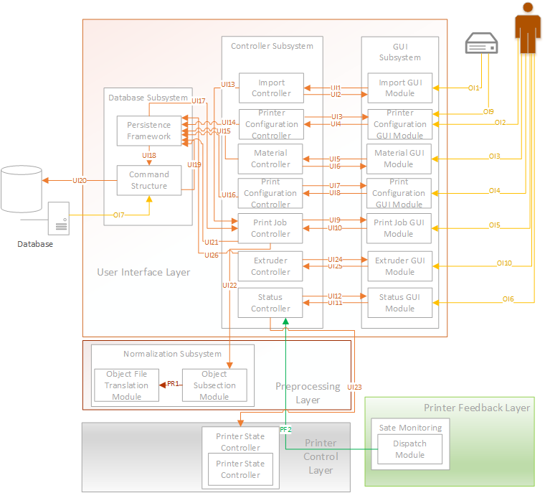
User Interface Layer

Slide 8
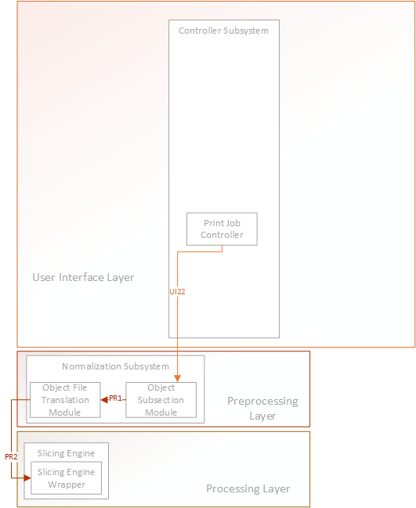
Preprocessing Layer

Slide 9
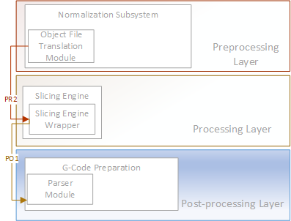
Processing Layer

Slide 10
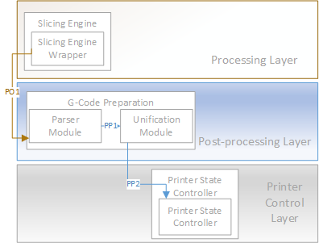
Post Processing Layer

Slide 11
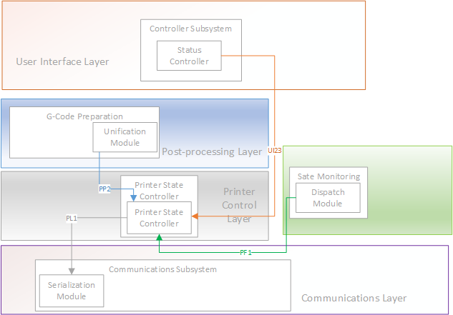
Printer Control Layer

Slide 12
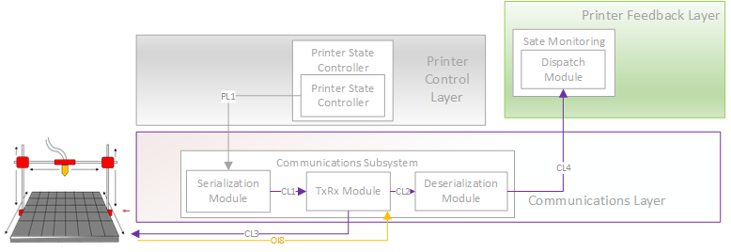
Communications Layer

Slide 13
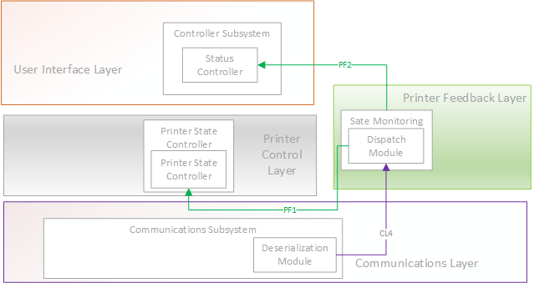
Printer Feedback Layer

